Slide 1
LOST &
FOUND
BING NEWS VERTICAL
MOBILE DESIGN EXPLORATION
MENTOR YAN YAN
YIFEI GONG SEPTEMBER 2019

Slide 2
Internship flashback
Sprints
Sprints
Ideation
Iteration
Sprints
Sprints

Slide 3
My Initial goal
Bing News Vertical
Mobile Experience
Notes:
So I’m going to unpack each current pain point and solution one by one.
The first one is lost focus which brought by long reading list, quick scrolling down and view the content in a same pattern.
People’s perception is getting flatten.

Slide 4
Common sense
NEWS=BREAKING
Notes:
Starting point

Slide 5
Actual feedback
READ NEWS=BORING
Notes:
News is a breaking image in common sense. But when people talking about is, people feel like reading news is boring.

Slide 6
Unmeted PAIN POINTS
Lost Interest
Feel the content is not attractive so not engaging
Lost Update
Hard to catch-up since last time read
Lost Control
Hard to prioritize favorite content
Notes:
The reasons behind it through my research are while reading new, lost focus, lost interest an lost update make them feel actively reading news is boring.

Slide 7
LOST
Notes:
Lost is certainly a passive word to describe the current experience.

Slide 8
FOUND
Opportunity AREA
Notes:
And the solutions I’ve explored are around Found.

Slide 9
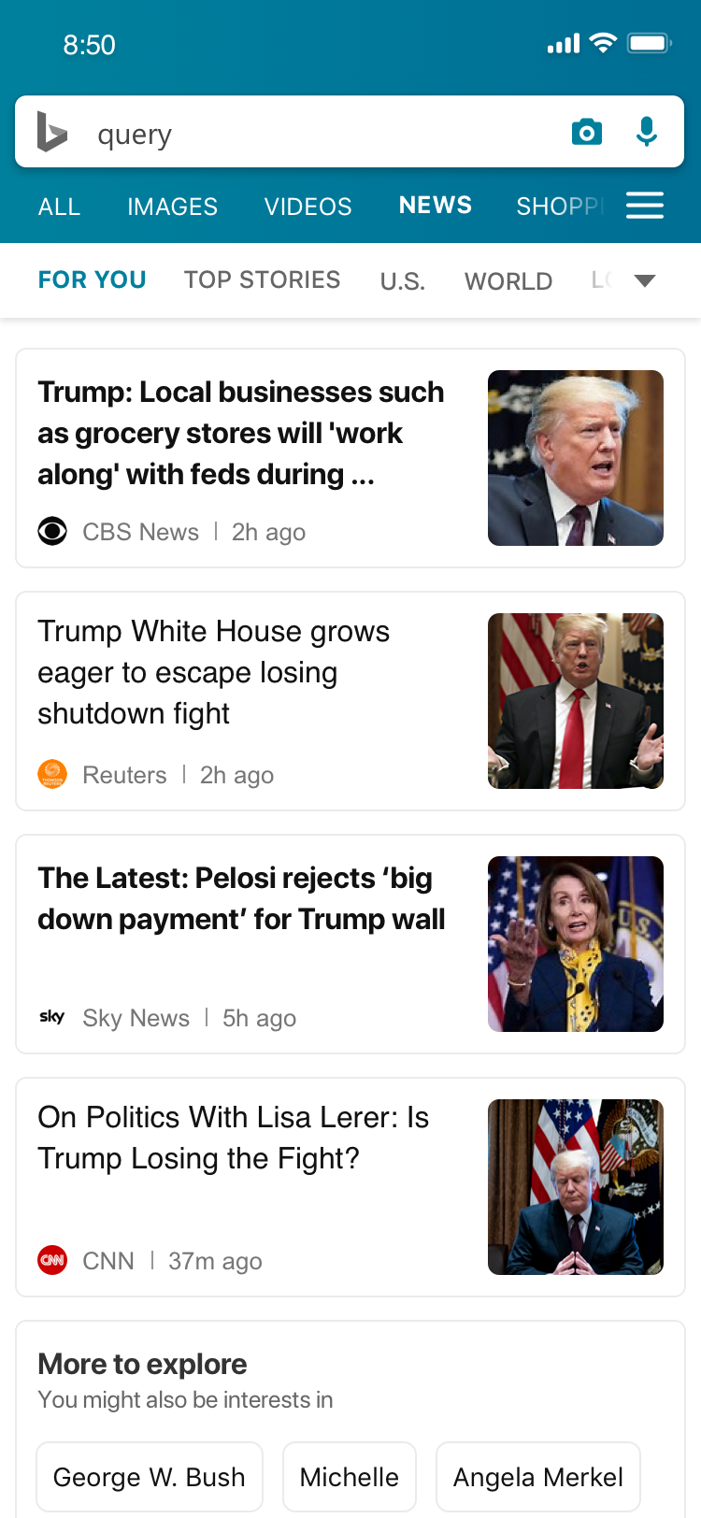
Showcase example
For You
Notes:
And the solutions I’ve explored are around Found.

Slide 10
PAIN POINT 1
LOST INTEREST
Feel the content is not attractive so not engaging
Notes:
But there is another part of this problem, why people lost their focus on our design, may be they couldn’t find the topics they are interested in.

Slide 11

Current Problem
Mobile news app users say they want personalized content, but few have taken steps to get it.
Mobile News Apps Survey Results, June 2017
Notes:
What could attract their focus?

Slide 12
Personalize On Desktop
MOBILE SCENARIO
Signed-in On Mobile
Browse News On Mobile
Back To Mobile And Read

Slide 13
User’s Expectation
People want easier, more immediate ways to personalize their feed to make it more useful and engaging.
Mobile News Apps Survey Results, June 2017
Notes:
What could attract their focus?

Slide 14
Personalize On Desktop
MOBILE SCENARIO
Signed-in On Mobile
Browse News On Mobile
Personalize On Mobile
Continue Tobrowse
Expected Efficiency
Shorter Path, No Scenario Shifting

Slide 15
Make An Easier And More Accessible
Content Personalization On Mobile
HMW

Slide 16
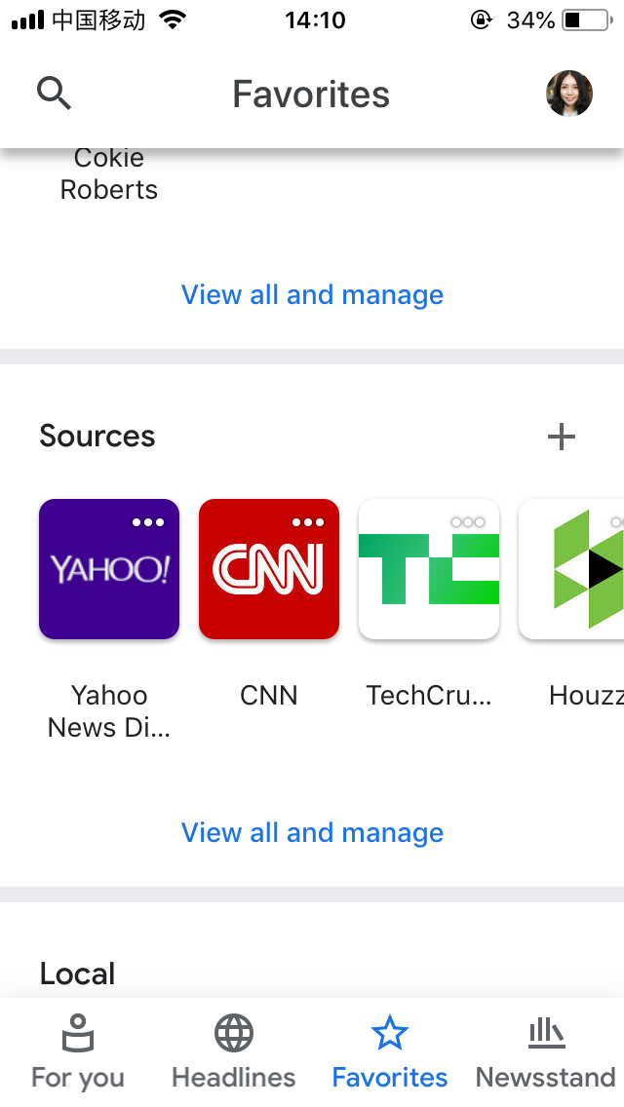
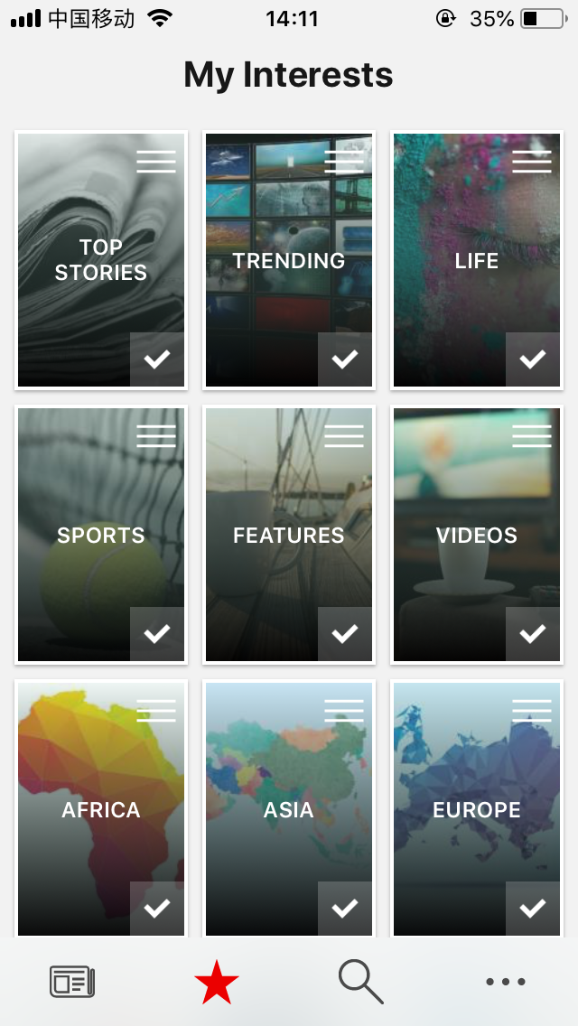
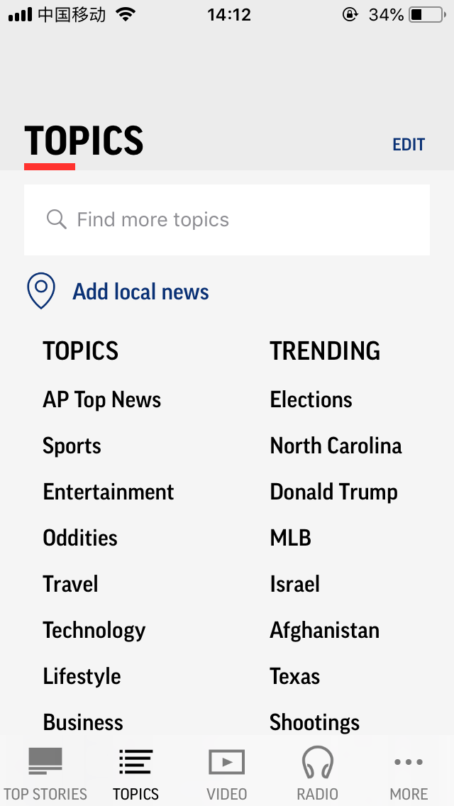
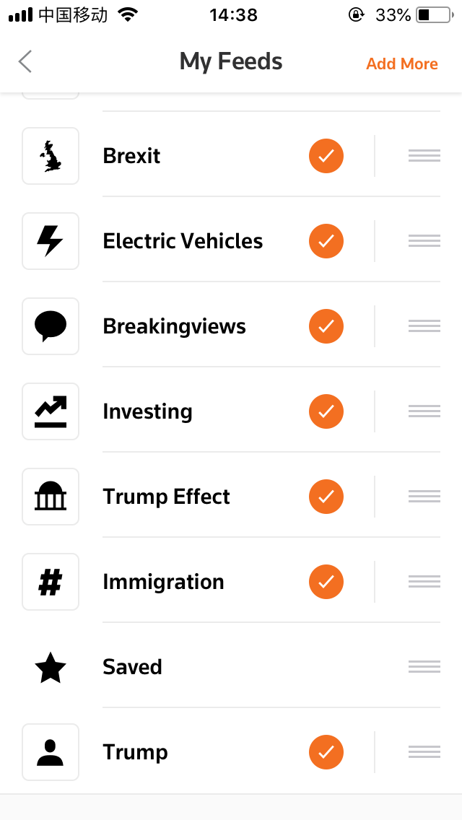
COMPETITOR WATCHING
Google News
Microsoft News
AP News
Reuters
Notes:
Google
2 Tabs
Various dimension to fit user’s mental model of content category
More than one

Slide 17
A NEW FUNCTION
REQUIRES
Awareness
Understanding
Action
HABIT FORMATION

Slide 18
Awareness
Understanding
Action
How To Let Users Know The Content In For You Could Be Personalized?

Slide 19
USER FLOW 1
For You
For You
Personalization
Personalize Now
Personalize Now
Later
Pop up
Quick Entry Point
Personalization Page

Slide 20
USER FLOW 2
For You
For You
Personalization
Personalize Now
Personalize Now
Later
Pop up
Quick Entry Point
Personalization Page

Slide 21
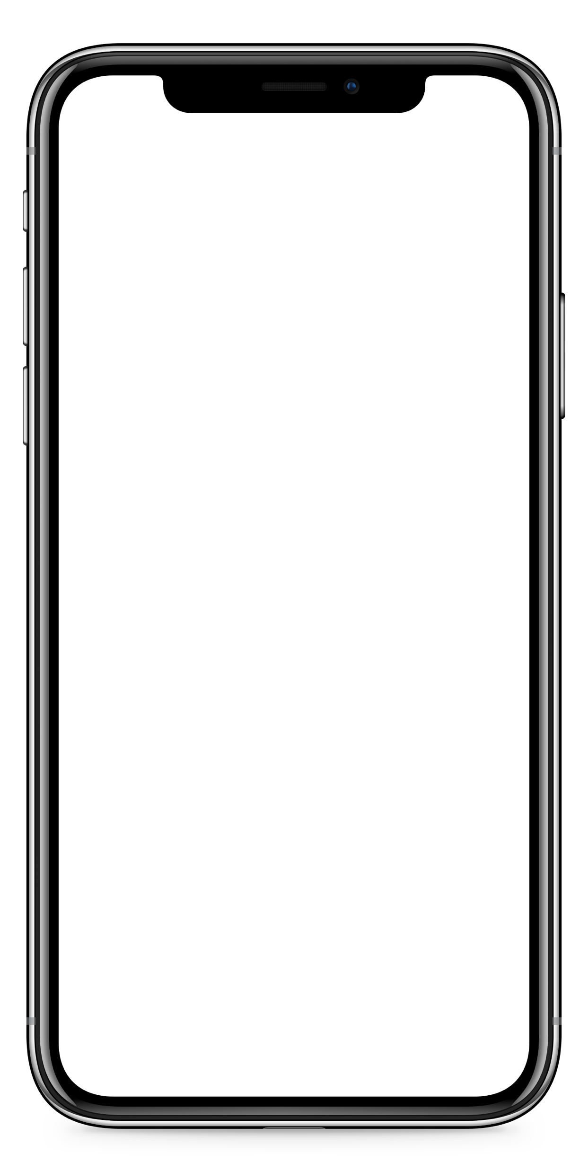
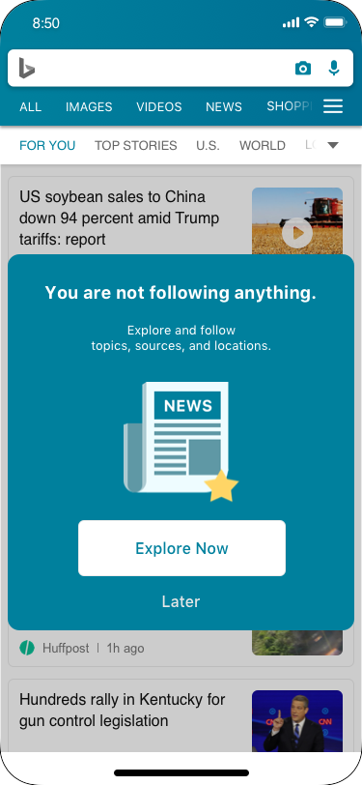
Directly Inform Users To Personalized Content
PERSONALIZATION POP UP

Slide 22
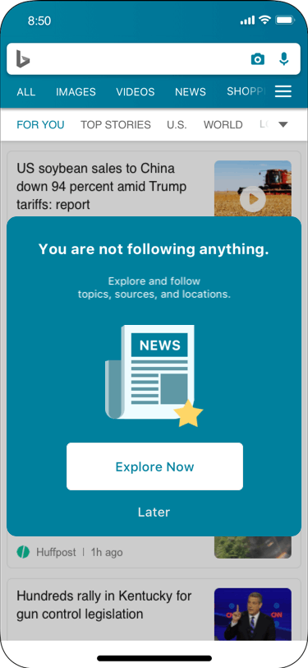
LATER
Allow Not Explore Now
Notes:
Not have intention to personalize content now
The pop up close and transform to a window on the top of the [for you] page

Slide 23
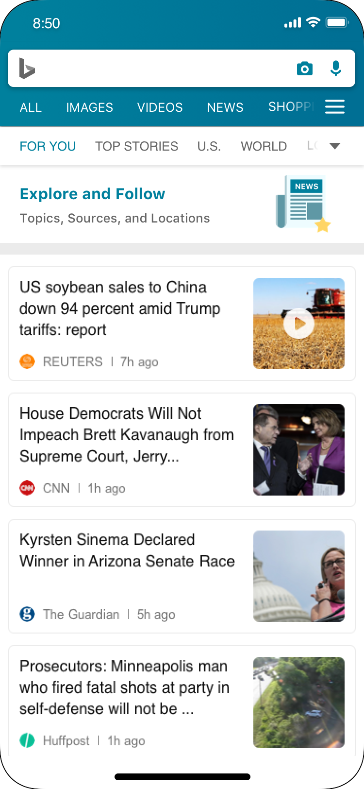
A Reminder For Personalization
Later ENTRY POINT
Notes:
Not have intention to personalize content now
The pop up close and transform to a window on the top of the [for you] page

Slide 24
Awareness
Understanding
Action
How to help users perceiving how to play with it?

Slide 25
User’s Expectation
Users prefer content to be organized by category/topic.
Mobile News Apps Survey Results, June 2017
Notes:
What could attract their focus?

Slide 26
Information Architecture
Following
Topics
Content
Sources
Not following
Locations

Slide 27
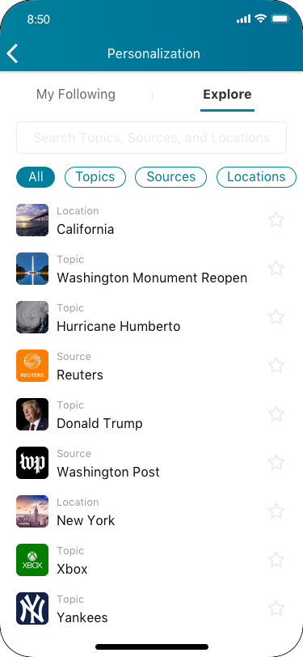
Well-organized List Structure
EXPLORE TAB-VIEW

Slide 28
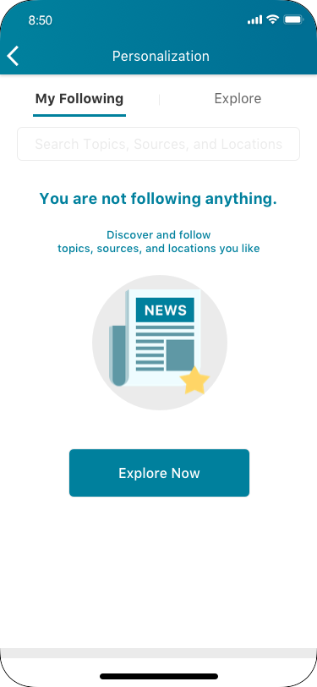
Encourage To Follow
MY FOLLOWING TAB-BLANK STATUS

Slide 29
Information Architecture
Following
Topics
Content
Sources
Not following
Locations

Slide 30
Quick Hands On
FILTER

Slide 31

Necessary Information
ITEM CARD
Notes:
Star filled
Location keep
For undo

Slide 32
Awareness
Understanding
Action
How to help users determine and take their action?
Notes:
View
Follow
Search
unfollow

Slide 33
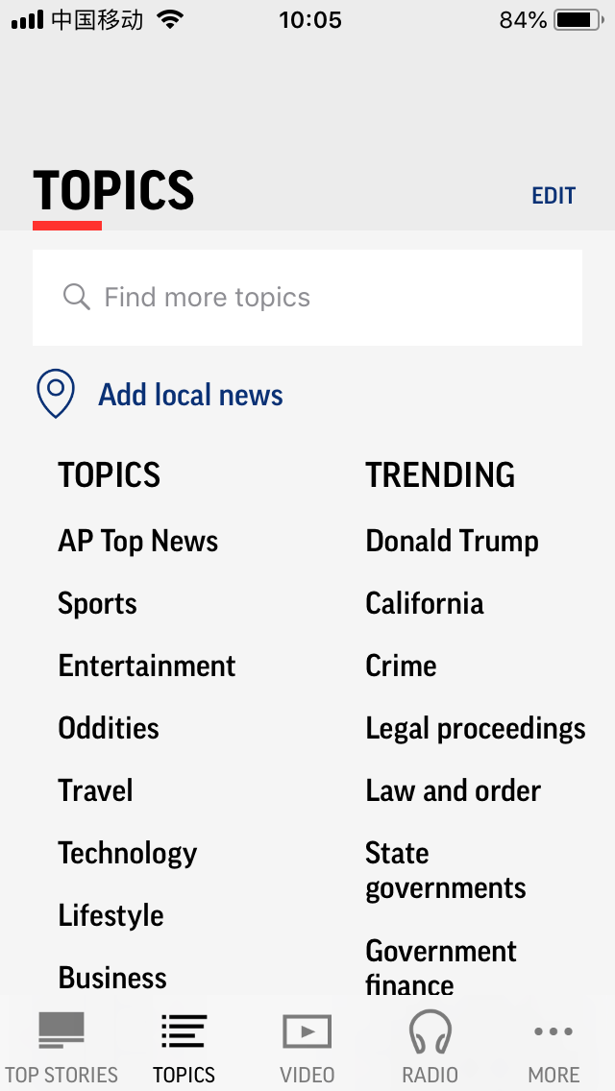
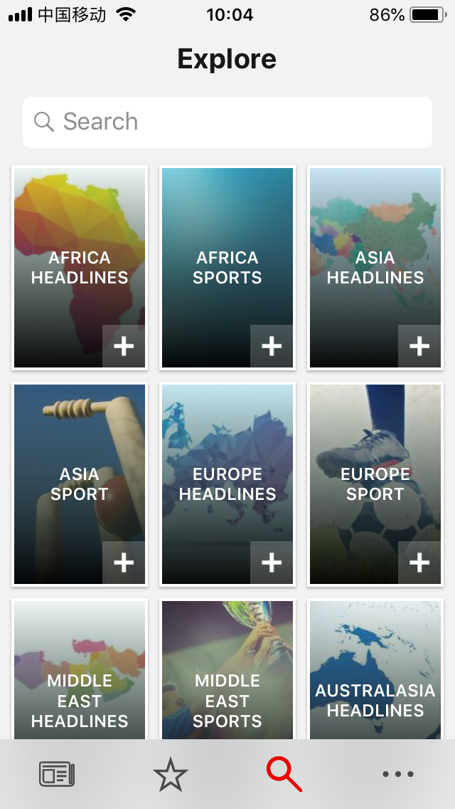
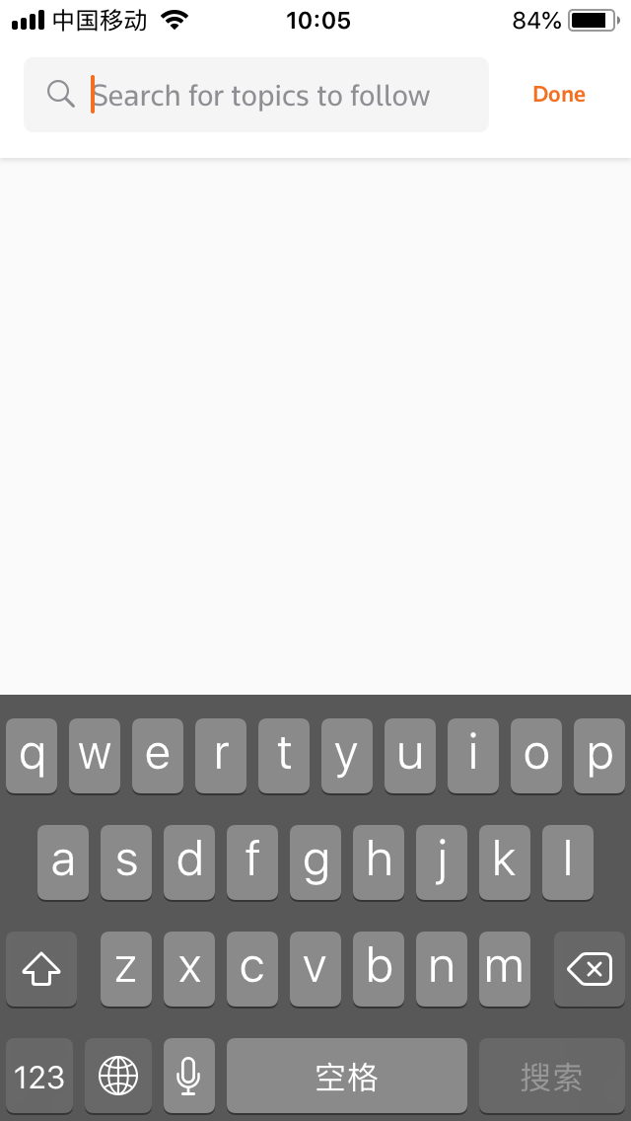
COMPETITOR WATCHING
Google News
Microsoft News
AP News
Reuters
Notes:
COMPETITOR ‘S SOLUTION
Flipboard
Fill, recommend
Microsoft news
Fill, recommend
Google News
Search, recommend
Reuters
Fill, Search

Slide 34
GOAL
Help User To Make Decision

Slide 35

Show clear Status
ITEM CARD
Notes:
Star filled
Location keep
For undo

Slide 36
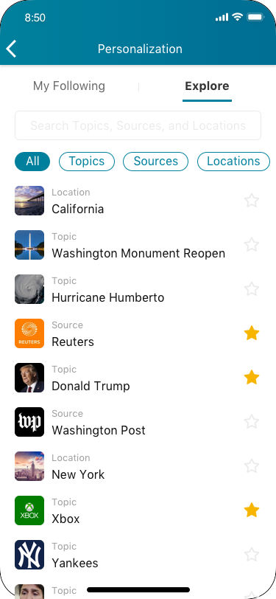
Easier For Decision Making By Narrowing Down Scope
FILTER
Notes:
Star filled
Location keep
For undo

Slide 37
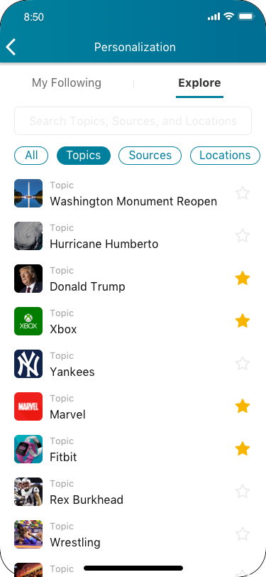
Easier For Decision Making By Narrowing Down Scope
FILTER

Slide 38
USER ACTIONS AND INTENTIONS
Users ACTIVELY find the target topics in their mind

Slide 39
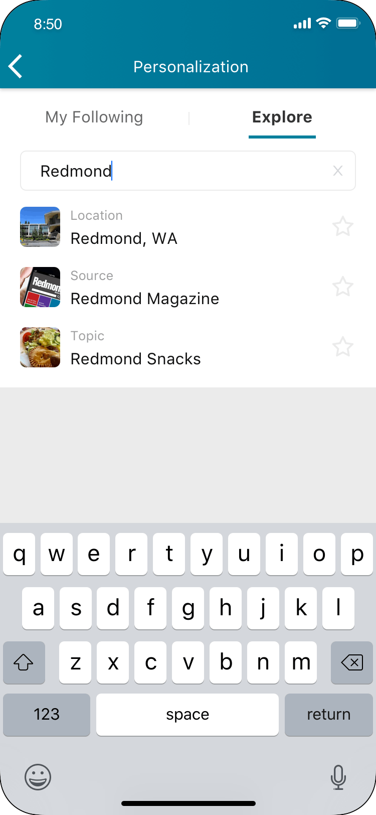
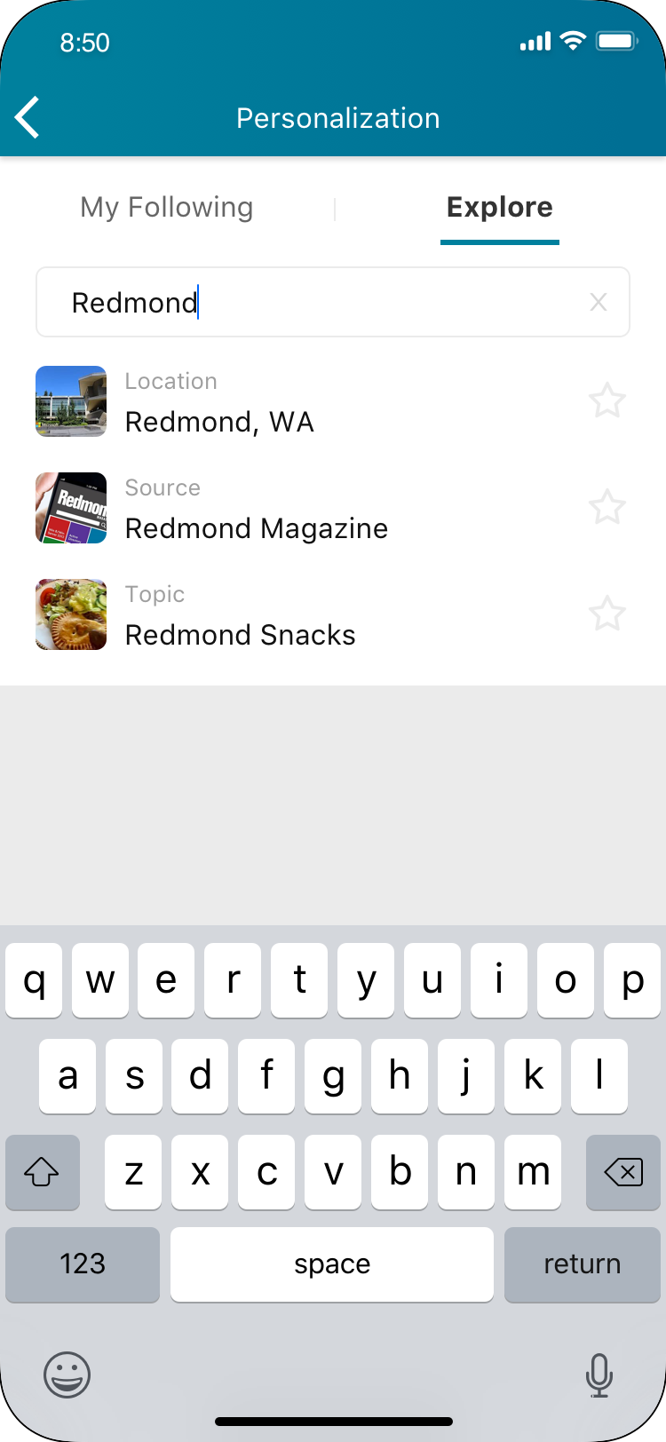
Differentiate Clearly
SEARCH

Slide 40
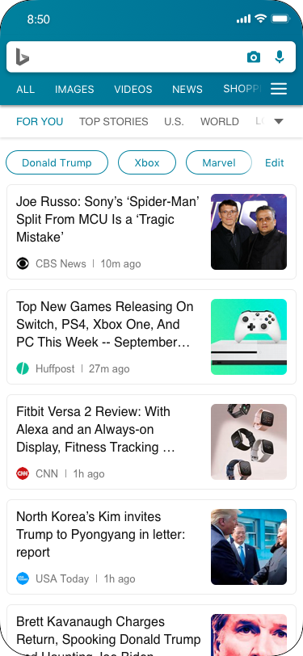
See Immediate Personalization Result
PERSONALIZATION COMPLETE
Notes:
After followed
You can see result immediately in my following

Slide 41
PAIN POINT 2
LOST UPDATES
Difficult to catch the new, unread content

Slide 42
Importance
Staying up-to-date is the primary reason people use mobile news apps.
Notes:
What could attract their focus?

Slide 43

scenario
Some Topics Has News Updates Being Generated In Every Second
Notes:
When they emerging in a long reading list, while scrolling down, the content is getting not up-to-date.

Slide 44
Why we care this?
74% of mobile news app users expect real-time content updates.
Mobile News Apps Survey Results, June 2017
Notes:
What could attract their focus?

Slide 45
Current workaround
Back to top
Refresh the list

Slide 46
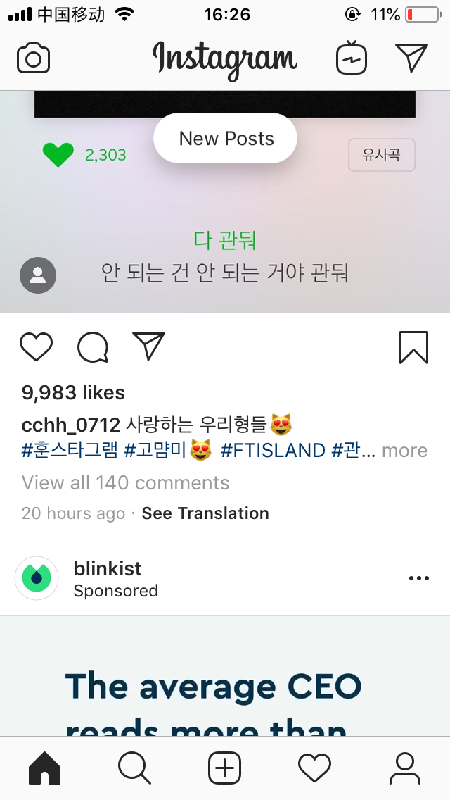
SOLUTION
Notes:
Instagram
A floating button to notify users new posts
Reuters
Tiny refresh notification with number on the top of the category page

Slide 47
Clear And Efficient
GOAL

Slide 48

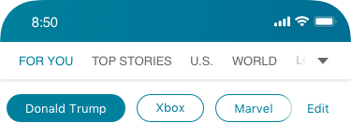
Less Effort Refreshing
NEW CONTENT NOTIFICATION
Notes:
On the top of the list area while a certain number of new articles are ready
Show the number of new articles and instructions
Go back to the list top and load the new articles
Search result
Top stories
For you
Category page
Pros
Able to know how many new article they could get and how to use this function
Cons
It won’t be triggered if only have a few new articles
Users don’t know the exact content of them, if tap, they also lost the current reading progress

Slide 49
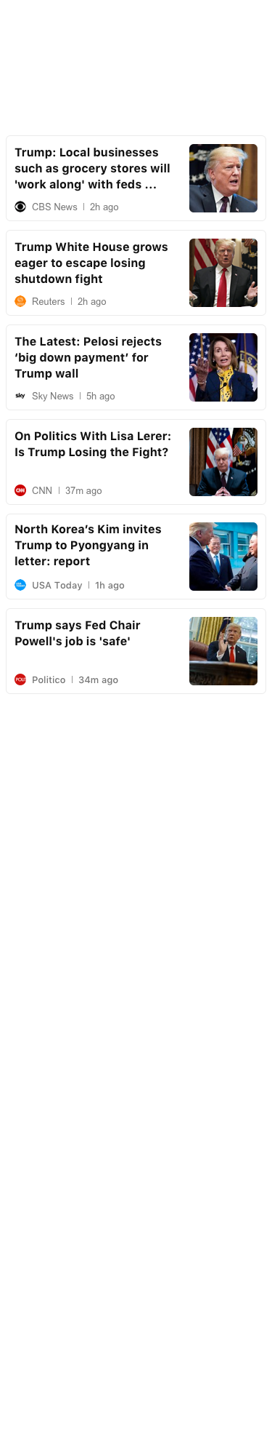

Less Effort Refreshing
NEW CONTENT NOTIFICATION
Notes:
On the top of the list area while a certain number of new articles are ready
Show the number of new articles and instructions
Go back to the list top and load the new articles
Search result
Top stories
For you
Category page
Pros
Able to know how many new article they could get and how to use this function
Cons
It won’t be triggered if only have a few new articles
Users don’t know the exact content of them, if tap, they also lost the current reading progress

Slide 50
Clear Update Indicator
RED DOT

Slide 51
Scenario
Recognize and separate read and unread in mind
by comparing time and recalling memory

Slide 52
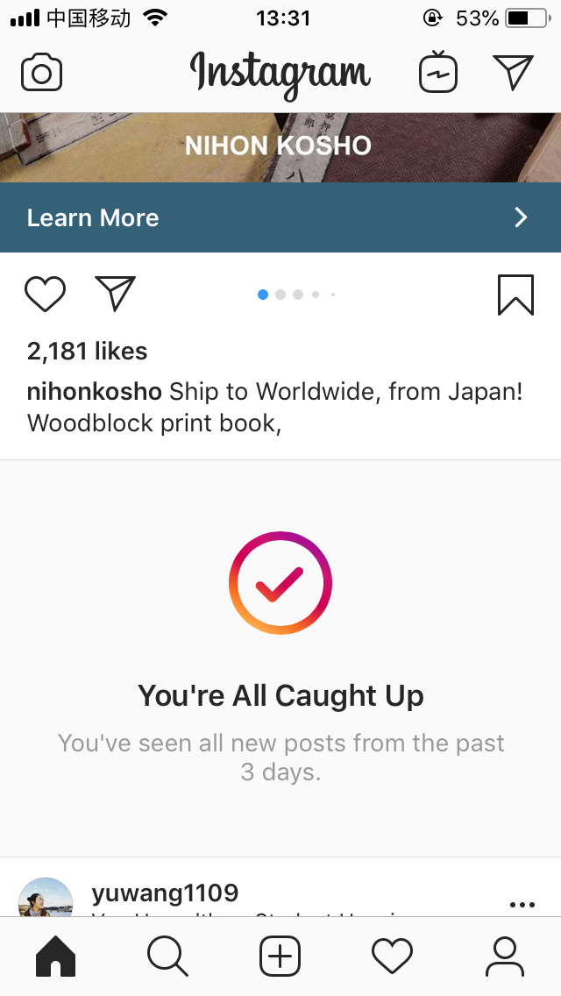
SOLUTION

Slide 53
Just Read
Last Time Read
Notes:
Current design is not efficient for user to diffrentieate the time or read/unread stutas of the content

Slide 54
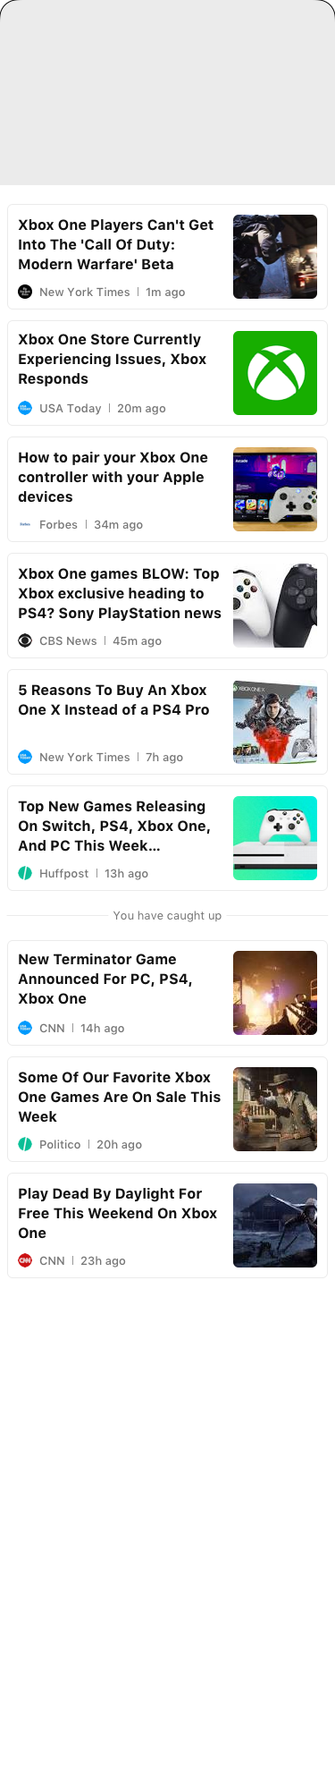
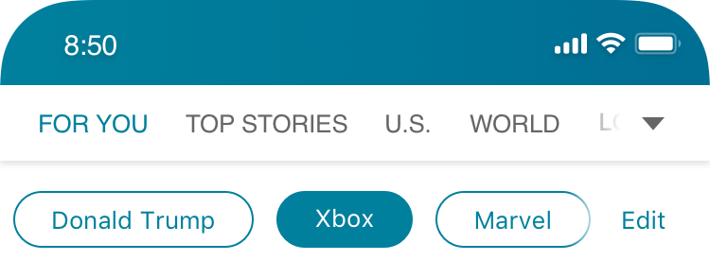
Light Separation Between Content
CATCH UP
Notes:
On the top of the list area while a certain number of new articles are ready
Show the number of new articles and instructions
Go back to the list top and load the new articles
Search result
Top stories
For you
Category page
Pros
Able to know how many new article they could get and how to use this function
Cons
It won’t be triggered if only have a few new articles
Users don’t know the exact content of them, if tap, they also lost the current reading progress

Slide 55
PAIN POINT 3
LOST CONTROL
Less Able To Control Things They Prefer To See
Notes:
So I’m going to unpack each current pain point and solution one by one.
The first one is lost focus which brought by long reading list, quick scrolling down and view the content in a same pattern.
People’s perception is getting flatten.

Slide 56
Finding
The priority of content is largely based on user’s personal preference. Users desire to control content, sources, and browse priority.
Notes:
What could attract their focus?

Slide 57
Clear Entry Point Fix Position Easy To Find
EDIT – Personalization Entry Point

Slide 58
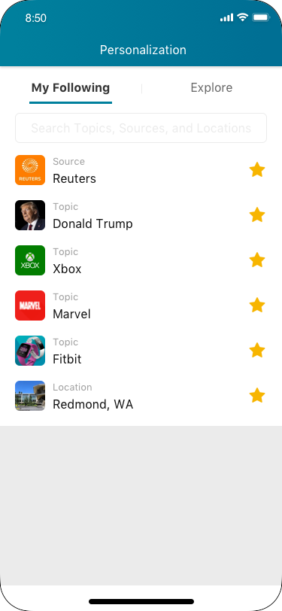
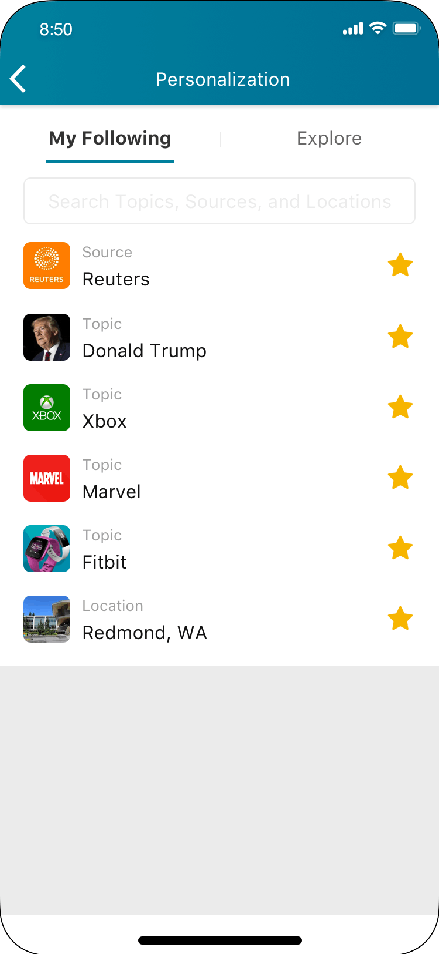
Easy To Unfollow
UNFOLLOW
Notes:
After followed
You can see result immediately in my following

Slide 59
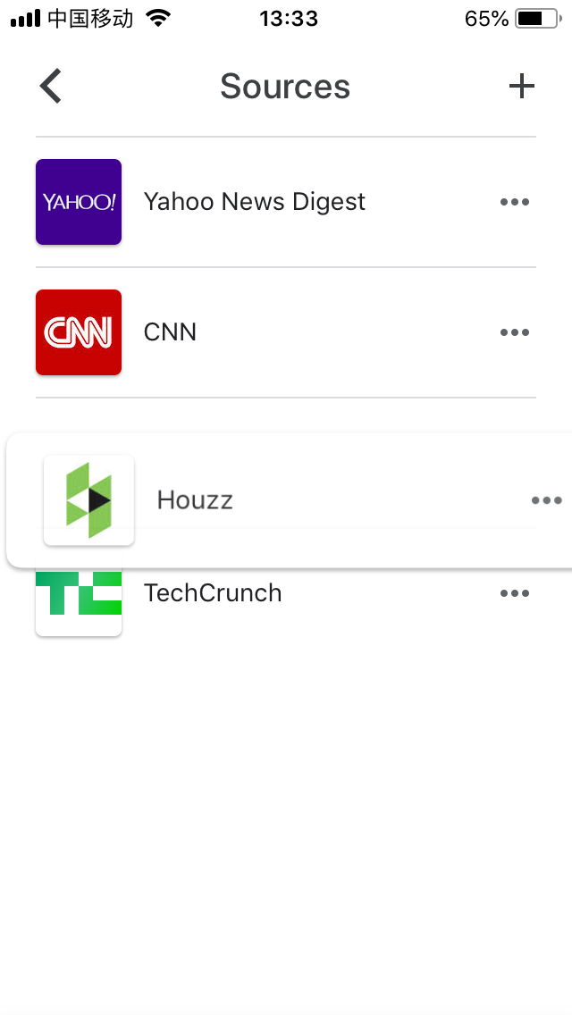
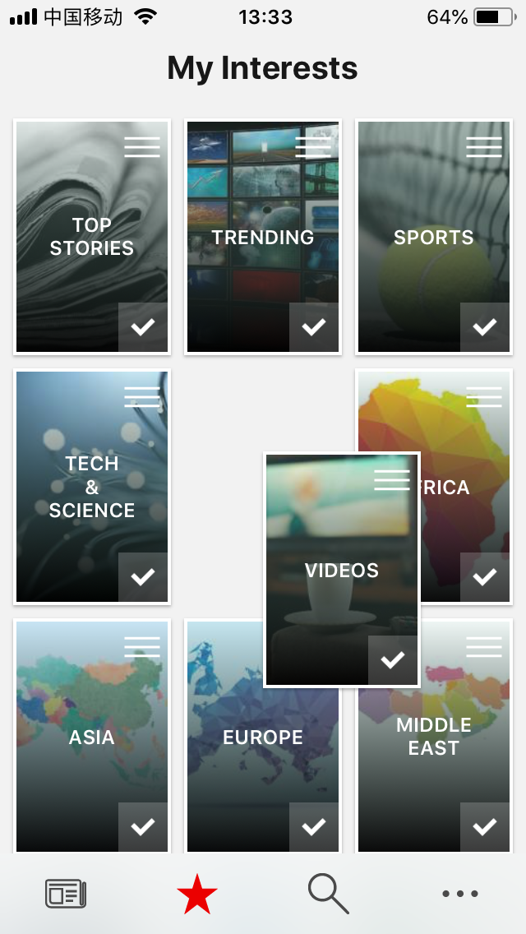
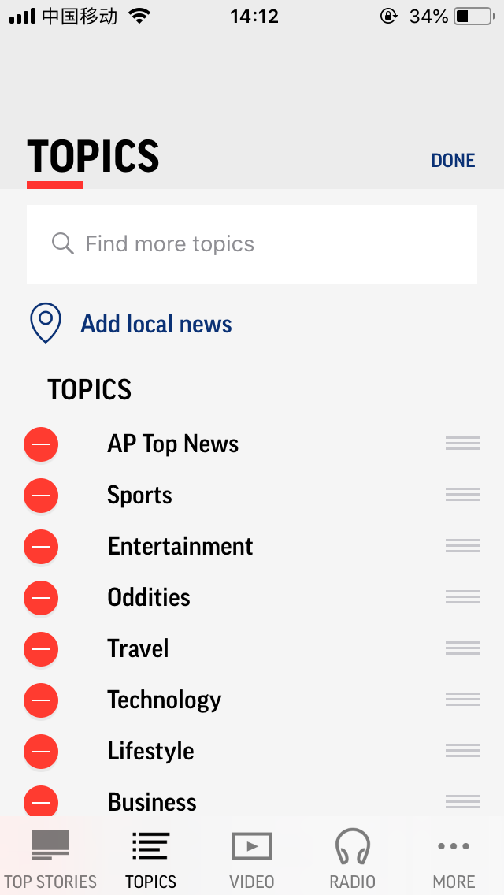
COMPETITOR WATCHING
Google News
Microsoft News
AP News
Reuters

Slide 60
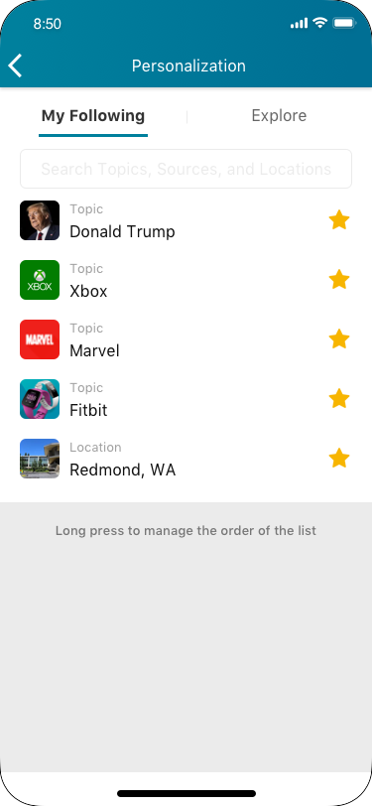
Less Learning Cost Better Function Discoverability
INSTRUCTION

Slide 61
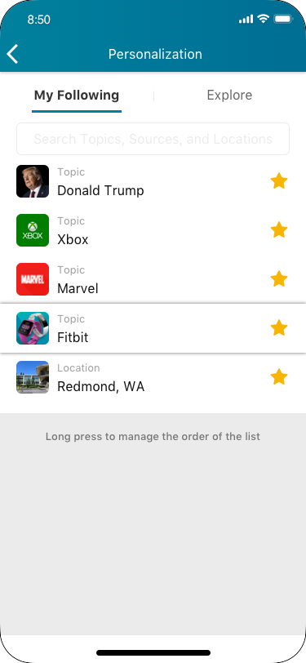
Less Possible Mis Manipulation
LONG PRESS STATUS

Slide 62
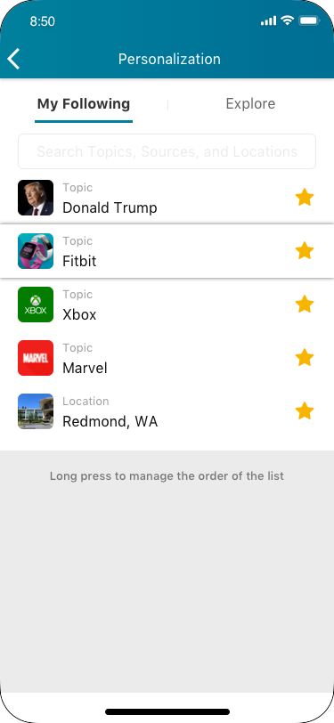
Directly See The Ordering Result
DRAG AND LOCATE

Slide 63
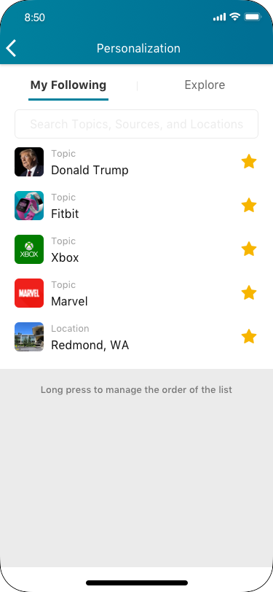
Finish Process Naturally
RELEASE AND COMPLETE

Slide 64

Immediate Result
VIEW RESULT

Slide 65
Lost Interest
Lost Update
Lost Control
Notes:
The reasons behind it through my research are while reading new, lost focus, lost interest an lost update make them feel actively reading news is boring.

Slide 66
Found
Personalized Content
Real-time And New Content
Prioritized Content
Notes:
And the solutions I’ve explored are around Found.

Slide 67
Internship Wrap up
Other Explorations

Slide 68
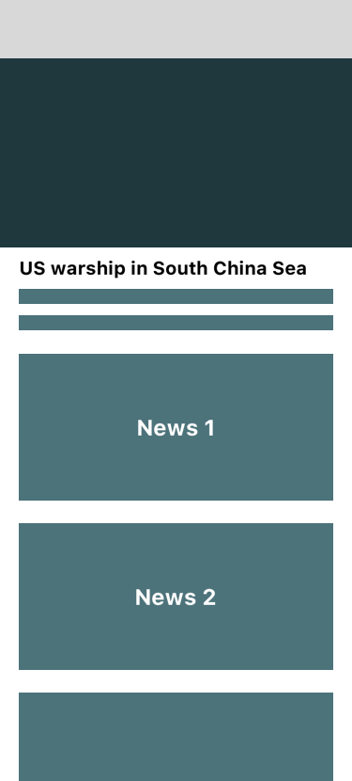
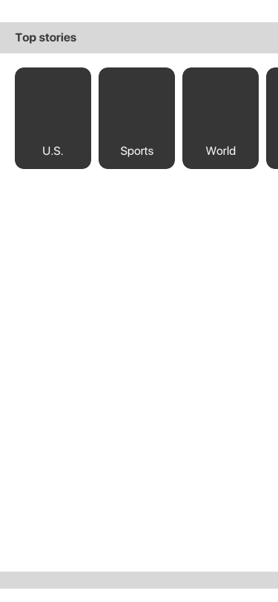



Slide 69
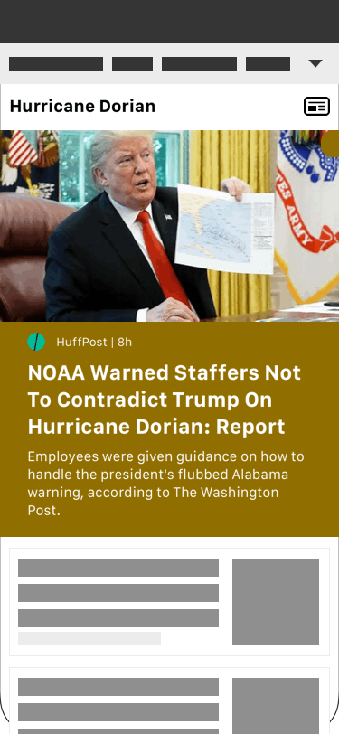

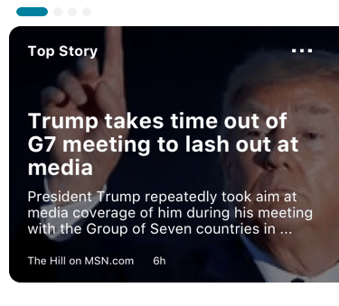
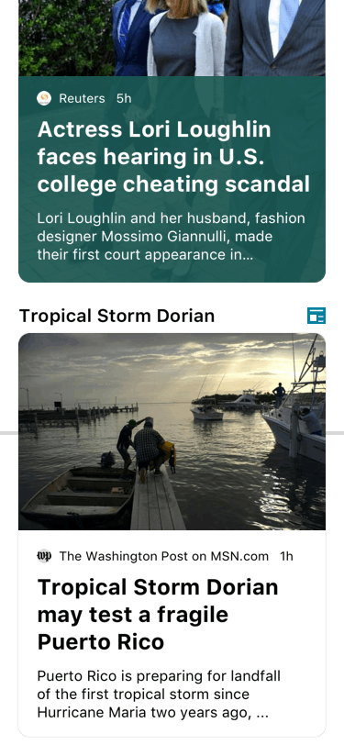
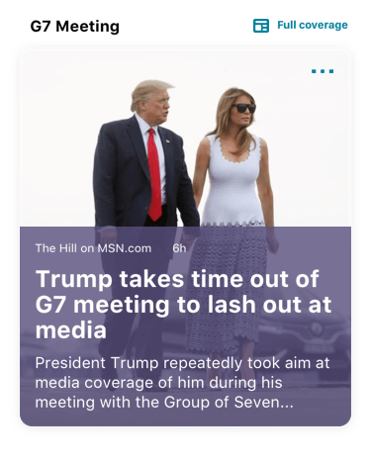
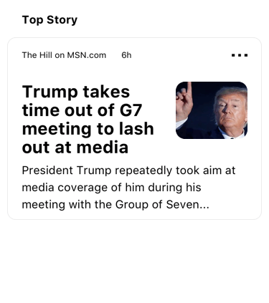

Slide 70
Alignment On Different Ends
Native And Web Interaction
Benefits And Efforts Balance
Reflections

Slide 71
Appreciate helps from
Yan Yan, Liyuan, Tang
Bing Team
Studio 8

Slide 72
Thank You!
Yifei Gong
2019/09/20

